Slide 1

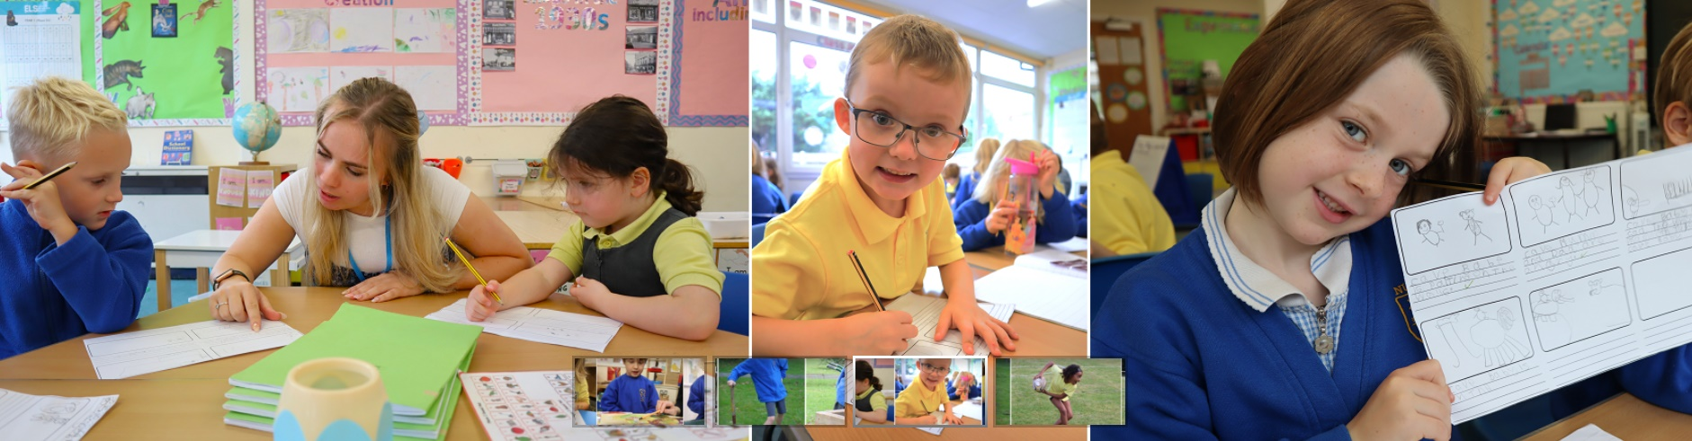
FWP3: Tuesday 17th June 2025

Slide 2

Final FMR & Review of Financial Performance 2024/25

Slide 3
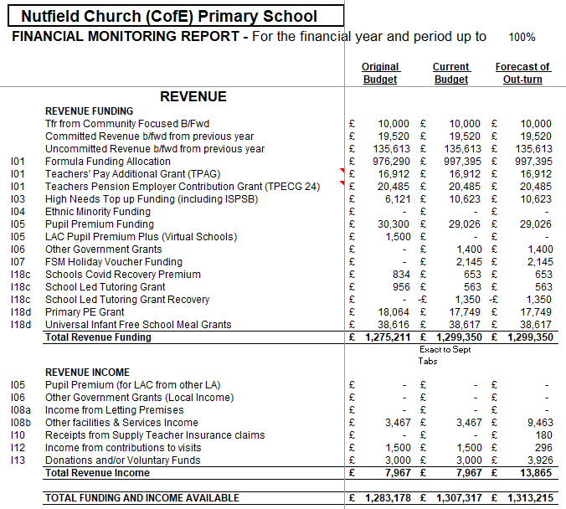
2024/25 Forecasted Funding
FY 2024/25 was budgeted at £1.275m for the year with an additional £8k of revenue income. Total centralised Funding+ income was therefore projected to be £1.283m overall for the financial year.
Actual funding came in at £1.299k some £24k higher than anticipated. This was predominantly driven by a £21k allocation for the Cores Schools Funing Grant which was allocated in November.
There were also material increases in high needs top up funding (£4.5k) and holiday voucher funding (£2.1k) neither of which had been foreseen at Budget submission. Additionally, revenue income saw a backdated interest payment of almost £6k.
Notable decreases to funding came in the form of Pupil premium funding (31.2k) driven by lower than projected FSM children and A recovery of a prior year funding item, School Led Tutoring Grant (£1.35k) which had been received and not expended in the previous financial Year
Total Available Funding + Income Closed at £1.313m

Slide 4
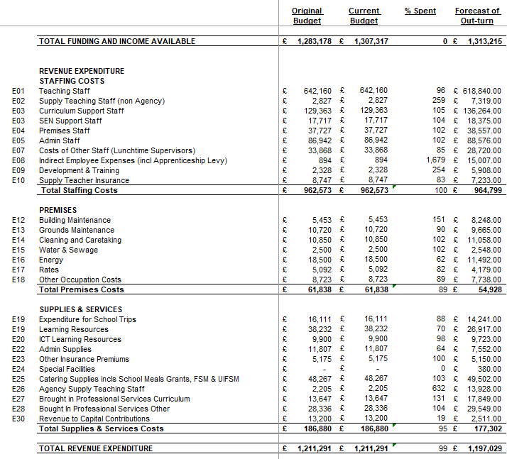
2024/25 Expenditure
Against a backdrop of £1.31m incomes expenditure throughout the year was carefully controlled.
Staff Cost expenditure came within £2k of the budgeted figure, although within the category there was significant movement across cost centres.
Teaching Staff costs were £23k lower than had been expected but was offset by non Agency Supply staff, Curriculum support and SEN provision (£13k).
There was a significant one off employment cost of £14k and uplifted Training Costs.
Premises expenditure closed the year overall around £7k better than expected despite buildings maintenance costing almost £3k more than anticipated.
Savings were made against Grounds maintenance (£1k) and Rates (£1k)
Savings of £7k were made against Energy owing to the significantly warmer winter and the installation of a more efficient water heater in November.
Supplies and Services was underspent by £10k in 2024/25 driven predominantly by an £11k underspend on learning resources and £4k on admin supplies.
Agency Supply Teaching costs were £11k overspent offsetting the Staff cost saving above
Revenue to capital contributions was lower than expected (£10.1k) due to furniture budgeted but not purchased in year.
Overall total expenditure came in at £1.197m vs budgeted £1.211m

Slide 5
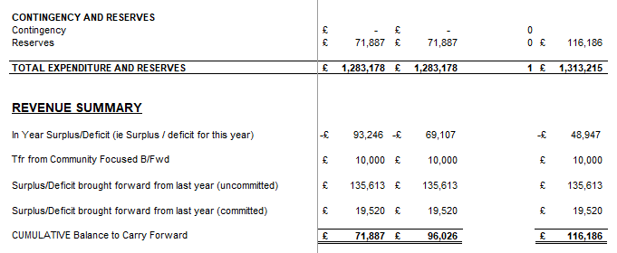
2024/25 Contingency & Reserves
At the time of budget submission it was anticipated that we would generate a reserve of almost £72k including a £10k transfer from community funding.
An aggregation of £30k in additional funding £2k of savings on Staff Costs, £7k savings on Premises and £9.5k saved on Supplies and services has culminated in the I year deficit reducing from the Projected -£93k to an actual of -£48k
The resultant cumulative balance to carry forward has significantly increased from the budgeted £71.8k to an actual carry forward of £116.1k

Slide 6
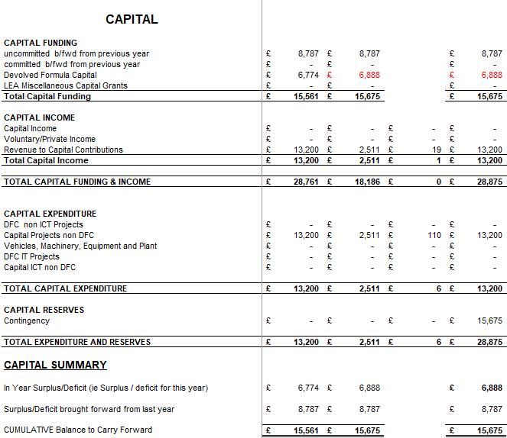
2024/25 Capital
Total Capital Funding for FY 24/25 was budgeted and came in at £15.6k
Capital incomes were driven entirely from Revenue to Capital contributions of £13.2k
Capital Projects expended were Classroom furniture at £2.5k and the replacement Water Heater at £12k.
As the contributions were matched to each project, the cumulative capital carry forward closed 2024/25 financial year at £15.6k

Slide 7
Final FMR & Review of Financial Performance 2024/25 - ARK

Slide 8
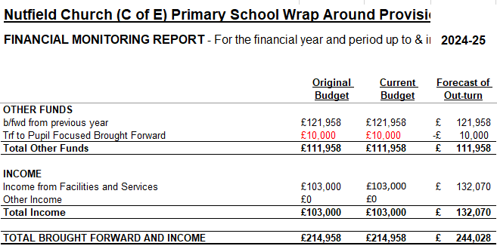
2024/25 Ark Revenue & Balances
Balance brought forward form Prior year was £121k
Contribution to Pupil focused was £10k (as previously shown in funding and income)
Forecasted Revenues were £103k for the fincial year however the year closed with revenues up 28% at £132k.
Total revenues including the brought forward balances were £244k

Slide 9

2025/26 Projected Out Turn

Slide 10
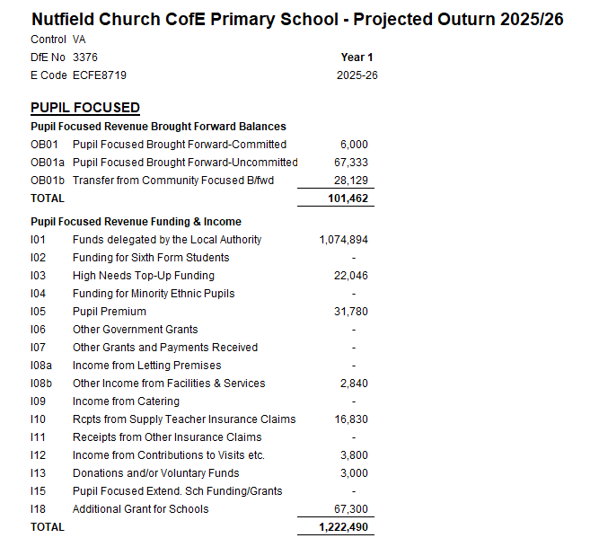
2025/26 Incomes and Revenue
Funding Delegated by the local Authority were just over £1m.
High Needs top Up Funding was positioned at £22k however no assumption has been made for any funding driven out of Yr R new intake requirements, This figure may rise.
Pupil Premium is as per the Budget assumptions as prior year had been used in the formula funding.
Receipts from insurance claims relates to maternity leave and whilst is not paid as “Funding” can be accrued throughout the year and a balancing payment made at the end of maternity.

Slide 11
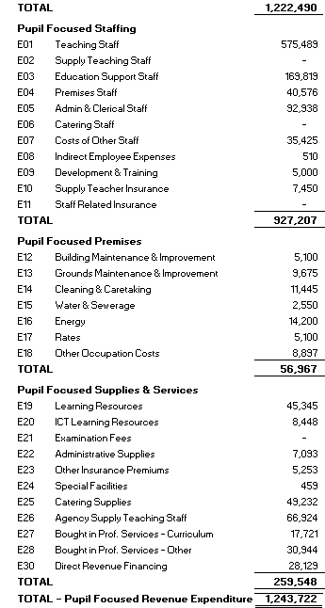
2025/26 Expenditure
See Additional Sheet

Slide 12

05
DFC

Slide 13
DFC Balance
Intrest paid against balances Held have totalled £300
£4500 taken as payment in December 2024 is against the future boiler works
2025 Allocation of funding is not yet determined

Slide 14
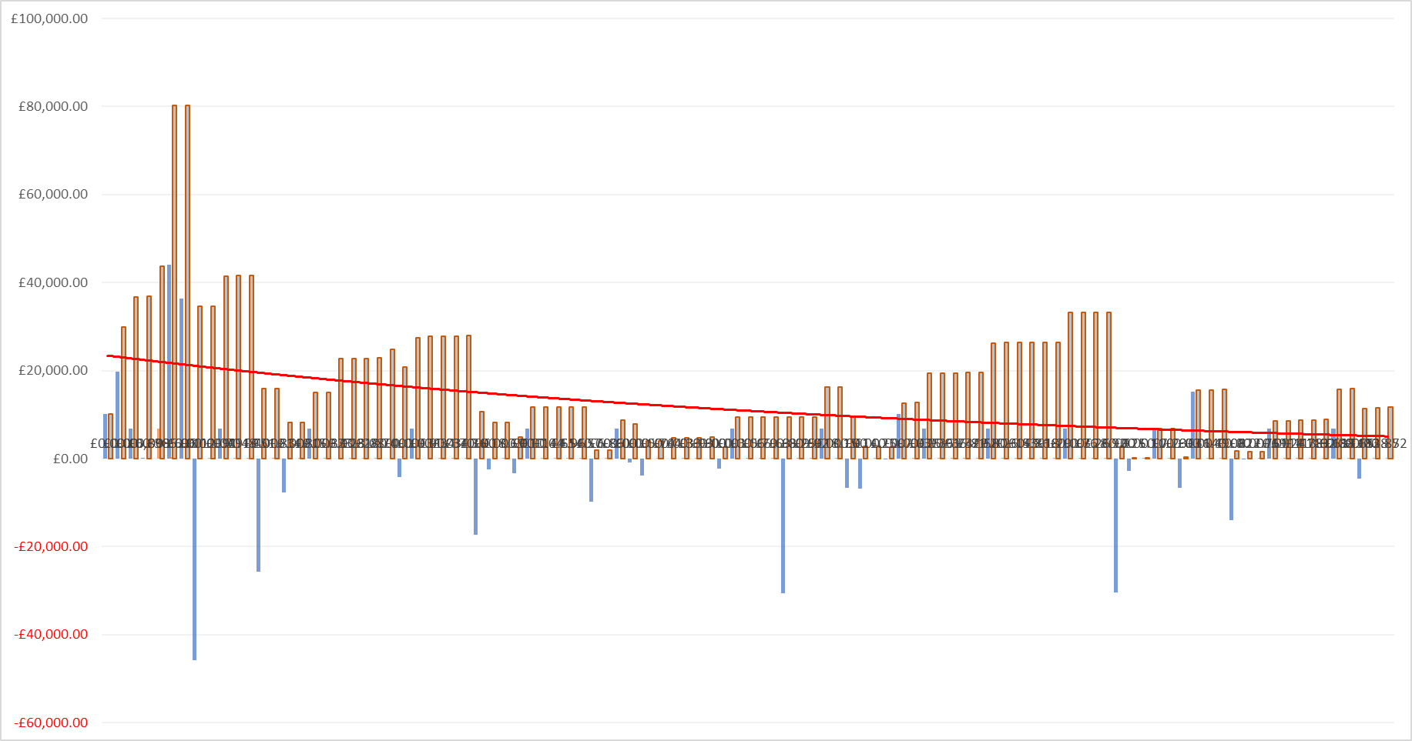
DFC Over Time

Slide 15
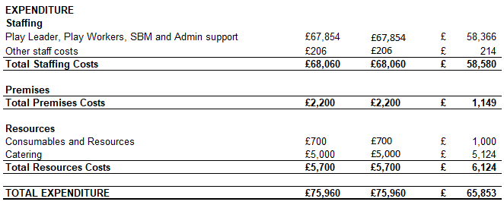

2024/25 Ark Expenditure
Total staff costs were projected to be in the region of £68k for the full year, however the final cost was £58.5k, a saving of £10k.
This was driven by utilizing fully expensed staff to backfill absence and vacancies.
Catering costs were marginally overspent.
Summary & Out Turn
“Gross Profit” on the ARK operation was £66k, 50% of revenues.
As a result the Cumulative balance to Carry forward for Ark is £178k

Slide 16

Schools Financial Value Standard

Slide 17
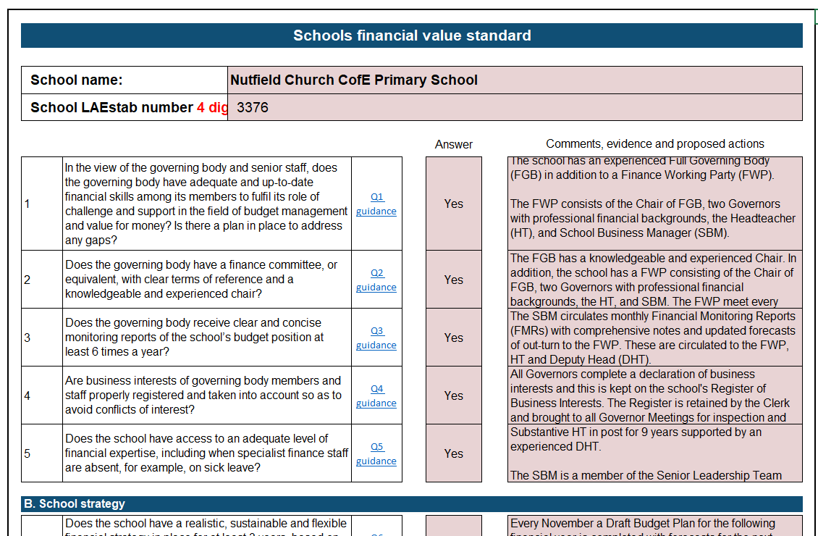
Schools Financial Value Standard
See Handout

